Slide 1
Notes:
How many of you have heard about cyberbullying? What do you know about it?
(Pause for audience response.)
Cyberbullying is exactly what it sounds like - bullying through technology like cell phones, social media sites and online games. Research tells us that:
About 32% of online teens ages 12-17 have been cyberbullied. ¹⁴
Girls are more likely to be targeted.¹⁵
Youth who identify as gay, lesbian, bisexual or questioning are more likely to be involved, both as a victim and a bully.¹⁶

Slide 2
Video
https://vimeo.com/251894069

Slide 3
Criminal Charges
Harassment
Menacing
With intent to harass, annoy, or alarm another person he or she:
Initiates communication with another person, anonymously or otherwise, by telephone, telephone network, data network, text message, instant message, computer, computer network, computer system, or other interactive electronic medium in a manner intended to harass or threaten bodily injury or property damage or makes any comment that is obscene.
By any threat or physical action, he or she knowingly places or attempts to place another person in fear of imminent serious bodily injury
Posting, possession, or exchange of a private image by a juvenile
Knowingly distributes, displays, or publishes to the view of another person a sexually explicit image of a person other than himself or herself who is at least fourteen years of age or is less than four years younger than the juvenile…..

Slide 4
Notes:
Some examples of cyberbullying include:
Sending someone mean texts.
Photoshopping or altering a picture to embarrass someone.
Creating a fake profile to post defamatory information or images.
Posting fight videos online to embarrass the person who lost.
Spreading rumors and gossip online.
Posting an embarrassing picture of someone with intent to embarrass.
Sending threatening or harassing comments.
Even young children who don’t use social media or cell phones can experience some form of cyberbullying while playing online games or playing in a virtual world. For example, they might be:
Exposed to inappropriate language while chatting.
Taunted by other players.
Targeted by more experienced players.

Slide 5
Notes:
Cyberbullying differs from regular bullying in a number of ways. It:
Often spreads faster than in-person bullying because of instant online communication.
Has a wider audience because it can easily be sent to a potentially unlimited amount of people.
Follows children home from school so they can’t get away from it.
All of this can undermine your child’s sense of security. Cyberbullies are usually peers they know, so they don’t feel safe at school because their bully is there, but now they don’t feel safe at home either because it’s happening 24/7 online.

Slide 6
Notes:
You may have heard a lot about cyberbullying in the news because of highly-publicized teen suicides. It’s important to remember that suicide as a result of cyberbullying is extremely rare.
Researchers have looked at cases of cyberbullying-related suicide and found that:¹⁵
Most teens who committed suicide were bullied both at school and online.
Many of the teens had some type of mental illness, such as depression.
This means that although cyberbullying can be extremely devastating for victims, most teens will not commit suicide solely as a result of the cyberbullying. There are usually other factors at play.
Examples in the News
Ryan Halligan suffered from developmental delays and was bullied at school and online for years. He received homophobic messages and was the victim of a prank when a girl at school pretended to like him online, but copied and pasted their private messages to others to embarrass him. He was 13 when he committed suicide.¹⁷
Megan Meier had ADD and battled depression. She had been exchanging messages on MySpace with a boy named Josh Evans, who one day turned on her and sent mean messages. After a heated exchange online, Megan committed suicide, just three weeks before her 14th birthday. Her parents later found out that Josh Evans was never real; he was allegedly made up by Megan’s former friend and her mother.¹⁸
Jessica Logan had sexted nude pictures to her boyfriend, but he forwarded them to others when they broke up to get revenge. Jessica was taunted and harassed by girls at school. Jessica committed suicide at the age of 18.¹⁹
Jamey Rodemeyer struggled for years with his sexuality and sought counseling for constant bullying online and at school. He posted a video to YouTube for the “It Gets Better” campaign to encourage other bullied youth to hang in there. He committed suicide at age 14.²⁰
Amanda Todd was harassed for years online and at school after a picture of her flashing a stranger on a webcam chat went viral. She suffered from anxiety and depression, and engaged in self harm. Amanda posted an emotional video to YouTube detailing her harassment and bullying, then committed suicide a month later at the age of 15.²¹

Slide 7
Notes:
As you can see, cyberbullying can have a tremendous impact on children. That’s why it’s so important for you to understand the issue. To combat cyberbullying, you need to know who is involved. Here are the major players:
Cyberbully - can be someone who instigates the bullying or someone who joins in.
Victim - the one being bullied, usually both online and offline.
Bystanders - those who stand by and watch the cyberbullying happen, but do nothing.
Your child likely falls in at least one of these categories, sometimes more than one because many children who are cyberbullied also cyberbully others. They have also probably been bystanders at one point or another. Let’s talk about how to address each of these categories.

Slide 8
Notes:
Because cyberbullying can be so far reaching, it greatly impacts its victims. If your child is being cyberbullied, he or she may:
Suddenly stop using the computer or cell phone.
Act nervous when receiving an email, IM or text.
Seem uneasy about going to school.
Withdraw from friends and family.
If you see any of these signs, don’t ignore them. Cyberbullying victims need to feel that you are taking the problem seriously and that you are going to do everything that you can to help.

Slide 9
Notes:
Here are some specific ways you can help if your child is a victim of cyberbullying:
Save the evidence - Take screenshots and print out any messages. If there is an investigation, you need proof of what was posted.
Block cyberbullies – Tell your child not to respond to the messages and take advantage of website features that allow you to block any user who is bothering you.
Set up new accounts - This includes email, IM, social media sites and cell phone numbers. Make sure they only give the new information to friends they trust.
Talk to the school - Remember, most cyberbullying involves in-person bullying by someone your child knows, usually a classmate. Teachers and administrators should work together on a plan to address the bullying in school, and they may have specific rules against cyberbullying, too.
Report it to the website or app where the cyberbullying is taking place - You might also be able to report unwanted text messages to your cell phone provider and block certain numbers.
If you feel that any laws have been broken or if your child has been threatened, then contact the police for help.

Slide 10
Notes:
Sometimes parents don’t find out that their children are cyberbullying others until they hear about it from another parent or from the school. Be proactive and look for these signs.
Your children may be involved with cyberbullying if they:²²
Quickly switch screens or close programs when you walk by.
Use the computer at all hours of the night.
Get unusually upset if they cannot use the computer.
Laugh excessively while online.
Avoid discussions about what they are doing.
Use multiple online accounts or use an account that is not their own .
If you notice any of these behaviors, get involved and ask them to show you what they’re doing.

Slide 11
Notes:
To help prevent your child from becoming a cyberbully, you can:
Establish expectations for online behavior - Make sure your child knows that you think bullying and cyberbullying are unacceptable.
Set consequences for cyberbullying - This will vary by family, but can include losing Internet privileges or more supervised Internet use.
Model good online behavior yourself - Children learn from the adults around them, so always be respectful of others online.
You don’t have to tell your children that they have to be friends with everyone, but you should teach them about respecting others. If you find out that your child has already been involved in cyberbullying, be open to working with the school as they look to correct the problem.

Slide 12
Notes:
Most kids are not bullies or victims; they are bystanders. They are afraid to speak up about cyberbullying because they’re afraid of being targeted next or being called a tattletale. However, information from bystanders is critical if teachers and other trusted adults are to take action.
Talk to your child about not being a bystander. You can do this by:
Establishing expectations for reporting - Make sure they understand that you expect them to speak up when they see cyberbullying happen because silence only lets it continue.
Encouraging them to stand up for the victim when they feel it’s safe to do so - That might mean being a good friend to the victim, telling the bully to stop or refusing to join in the cyberbullying. They can also show support to the victim in private.
Helping them report the cyberbullying to a website where the cyberbullying is taking place or to a trusted adult at school - Bystanders will feel better about reporting if they are reassured they’re doing the right thing, so help them see it through.

Slide 13
Notes:
You’ve now heard several strategies to help you deal with online predators, revealing too much personal information, posting inappropriate images and cyberbullying. Most of those suggestions have been based on communicating with your children, but I also want to talk about technological solutions.
Here are some options you may want to look into:
Filtering and monitoring software - These can help protect your children from seeing sexually explicit content online and even notify you if they’re receiving inappropriate messages. NetSmartz does not endorse any particular kind of software, but you can go to www.getnetwise.org to search for the software that best fits your needs.
Consult your cell phone provider - They may offer monitoring options for your child’s cell phone.
Research options for mobile devices – Laptops, tablets, handheld games and MP3 players may have built-in monitoring options or software for purchase.
Look at the individual apps they’re using - Many apps have the option to turn off chat features or limit who can see what your child posts within the app.
Explore built-in security features for programs and websites - These often have their own privacy or filtering services. For example, Google has a free SafeSearch option.

Slide 14
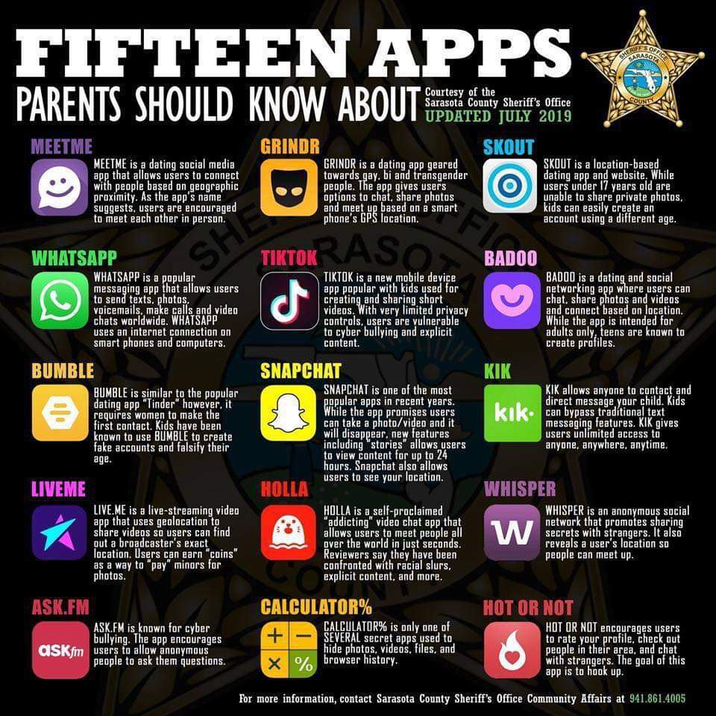

Slide 15
Apps for Parents
Our Pact
Kidslox
Screen Time

Slide 16
Notes:
But remember, the most important thing is to communicate with your children about what they’re doing online. Start the conversation by asking about their interests.
Ask them questions like:
What’s your favorite app?
Who do you talk to when you play games?
What kinds of pictures do you like to post?
Discuss these things with them regularly so they know you’re available and have an open mind. Kids need to know that you won’t freak out and pull the plug if something happens online. You may not be able to protect them from everything, but you can teach them how to make responsible choices when they encounter a problem.

Slide 17
Simon Sinek
https://www.youtube.com/watch?v=sL8AsaEJDdo

Slide 18
Questions

